Slide 1
Boolean Algebra and Logic Simplification
Part 2
Course : CPEN6265010 Digital System
Effective Period : September 2025

Slide 2
Related LO
Learning Objectives
LO1: Analyze and Design Combinational Logic Circuits.

Slide 3
Outlines
Boolean Analysis of Logic Circuits
Logic Simplification Using Boolean Algebra
Standard Forms of Boolean Expressions
The Karnaugh Map

Slide 4
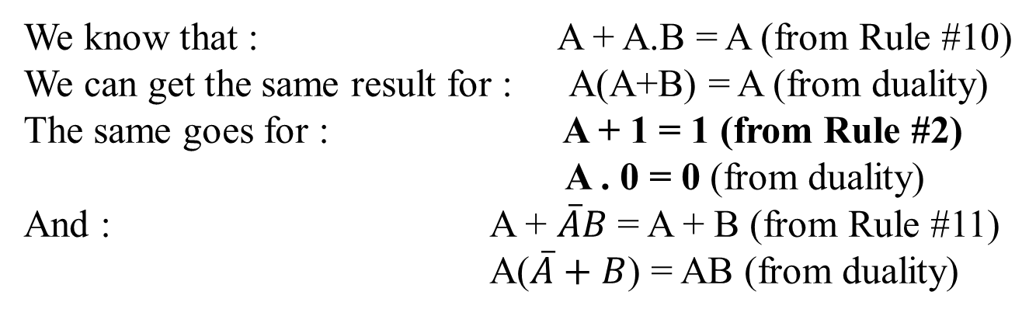
Boolean Analysis of Logic Circuits
Every algebraic expression deducible from the postulates of Boolean algebra remains valid if the operators and identity elements are interchanged.
If the dual of an algebraic expression is desired, we simply interchange OR and AND operators and replace 1’s by 0’s and 0’s by 1’s.
Example
We know that : A + A.B = A (from Rule #10)
We can get the same result for : A(A+B) = A (from duality)
The same goes for : A + 1 = 1 (from Rule #2)
A . 0 = 0 (from duality)
And : A + $\overline{A}B$ = A + B (from Rule #11)
A($\overline{A}+B$) = AB (from duality)

Slide 5
Boolean Analysis of Logic Circuits
Combinational logic circuits can be analyzed by writing the expression for each gate and combining the expressions according to the rules for Boolean algebra.
Example
Apply Boolean algebra to derive the expression for X.
Solution
Write the expression for each gate:
(A + B )
C (A + B )
= C (A + B )+ D
X
Applying DeMorgan’s theorem and the distribution law:
X = C (A . B) + D = A B C + D

Slide 6
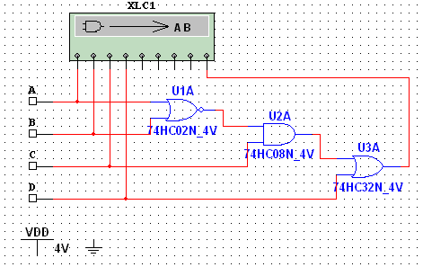
Boolean Analysis of Logic Circuits
Example
Use Multisim to generate the truth table for the circuit in the previous example.
Solution
Set up the circuit using the Logic Converter as shown. (Note that the logic converter has no “real-world” counterpart.)
Double-click the Logic Converter top open it. Then click on the conversion bar on the right side to see the truth table for the circuit (see next slide).

Slide 7
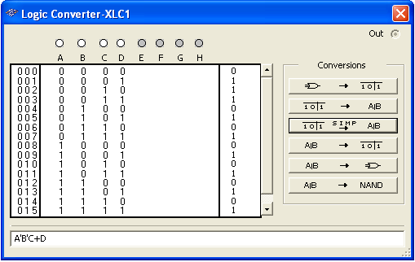
Boolean Analysis of Logic Circuits
The simplified logic expression can be viewed by clicking
Simplified expression

Slide 8
Standard Forms of Boolean Expressions
Boolean expressions can be written in the sum-of-products form (SOP) or in the product-of-sums form (POS). These forms can simplify the implementation of combinational logic, particularly with PLDs. In both forms, an overbar cannot extend over more than one variable.
An expression is in SOP form when two or more product terms are summed as in the following examples:
A B C + A B A B C + C D C D + E
An expression is in POS form when two or more sum terms are multiplied as in the following examples:
(A + B)(A + C) (A + B + C)(B + D) (A + B)C

Slide 9
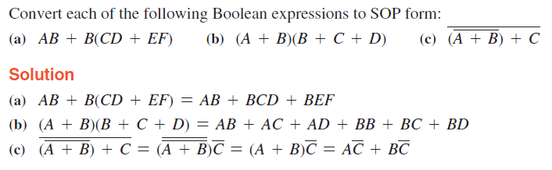
Standard Forms of Boolean Expressions

Slide 10
Standard Forms of Boolean Expressions
In SOP standard form, every variable in the domain must appear in each term. This form is useful for constructing truth tables or for implementing logic in PLDs.
You can expand a nonstandard term to standard form by multiplying the term by a term consisting of the sum of the missing variable and its complement.
Example
Convert X = A B + A B C to standard form.
Solution
The first term does not include the variable C. Therefore, multiply it by the (C + C), which = 1:
X = A B (C + C) + A B C
= A B C + A B C + A B C

Slide 11
Standard Forms of Boolean Expressions
The Logic Converter in Multisim can convert a circuit into standard SOP form.
Example
Use Multisim to view the logic for the circuit in standard SOP form.
Solution
Click the truth table to logic button on the Logic Converter.
See next slide…

Slide 12

Standard Forms of Boolean Expressions
SOP Standard form

Slide 13
Standard Forms of Boolean Expressions
In POS standard form, every variable in the domain must appear in each sum term of the expression.
You can expand a nonstandard POS expression to standard form by adding the product of the missing variable and its complement and applying rule 12, which states that (A + B)(A + C) = A + BC.
Example
Convert X = (A + B)(A + B + C) to standard form.
Solution
The first sum term does not include the variable C. Therefore, add C C and expand the result by rule 12.
X = (A + B + C C)(A + B + C)
= (A +B + C )(A + B + C)(A + B + C)

Slide 14

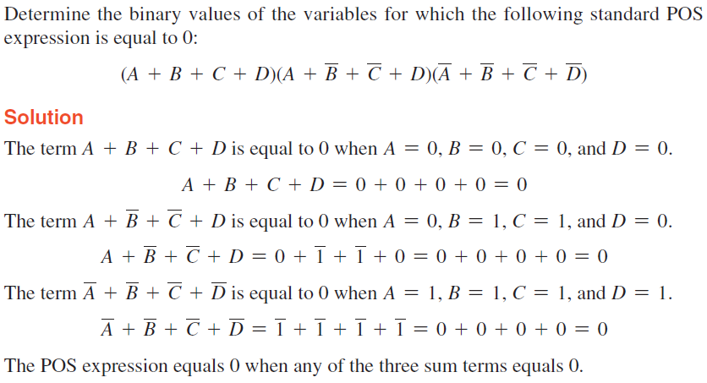
Standard Forms of Boolean Expressions
The Binary representation of a standard product term is equal to 1 for only one combination of variable values.

Slide 15
Standard Forms of Boolean Expressions
To convert from standard SOP to standard POS, the following steps are taken :
Evaluate each product term in the SOP expression. That is, determine the binary numbers that represent the product terms.
Determine all of the binary numbers not included in the evaluation in Step 1.
Write the equivalent sum term for each binary number from Step 2 and express in POS form.
Using a similar procedure, you can go from POS to SOP.

Slide 16
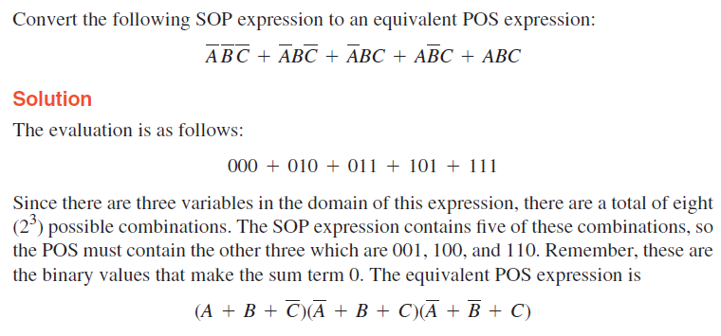
Standard Forms of Boolean Expressions

Slide 17



Standard Forms of Boolean Expressions
Convert the following expression to standard form :
Convert the following expression to POS form :
Convert the following expression to SOP form :

Slide 18
The Karnaugh Map
The Karnaugh map (K-map) is a tool for simplifying combinational logic with 3 or 4 variables. For 3 variables, 8 cells are required (2³).
The map shown is for three variables labeled A, B, and C. Each cell represents one possible product term.
Each cell differs from an adjacent cell by only one variable.

Slide 19
The Karnaugh Map
Cells are usually labeled using 0’s and 1’s to represent the variable and its complement.
The numbers are entered in gray code, to force adjacent cells to be different by only one variable.
Gray code
Ones are read as the true variable and zeros are read as the complemented variable.

Slide 20
The Karnaugh Map
Alternatively, cells can be labeled with the variable letters. This makes it simple to read, but it takes more time preparing the map.
C C
Example
Read the terms for the yellow cells.
AB
AB
AB
AB
Solution
The cells are ABC and ABC.

Slide 21
The Karnaugh Map
K-maps can simplify combinational logic by grouping cells and eliminating variables that change.
Example
Group the 1’s on the map and read the minimum logic.
Solution
1. Group the 1’s into two overlapping groups as indicated.
Read each group by eliminating any variable that changes across a boundary.
B changes across this boundary
The vertical group is read AC.
C changes across this boundary
The horizontal group is read AB.
X = AC +AB

Slide 22
The Karnaugh Map
A 4-variable map has an adjacent cell on each of its four boundaries as shown.
Each cell is different only by one variable from an adjacent cell.
Grouping follows the rules given in the text.
The following slide shows an example of reading a four variable map using binary numbers for the variables…

Slide 23
The Karnaugh Map
Example
Group the 1’s on the map and read the minimum logic.
C changes across outer boundary
Solution
1. Group the 1’s into two separate groups as indicated.
Read each group by eliminating any variable that changes across a boundary.
B changes
B changes
The upper (yellow) group is read as AD.
The lower (green) group is read as AD.
C changes
X
X = AD +AD

Slide 24
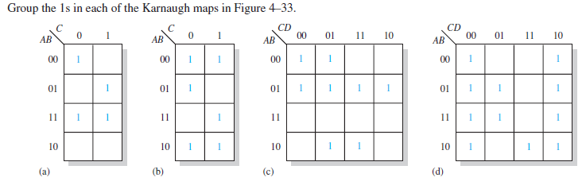
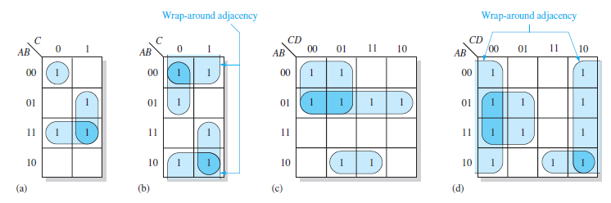
The Karnaugh Map

Slide 25
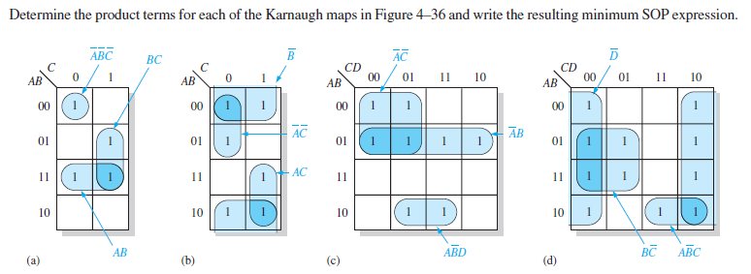

The Karnaugh Map

Slide 26

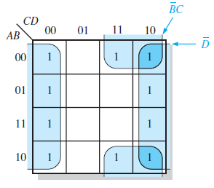

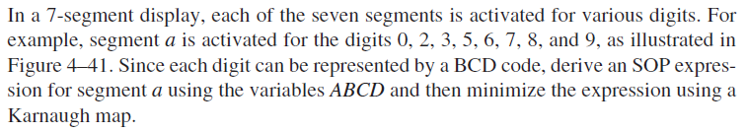
The Karnaugh Map

Slide 27
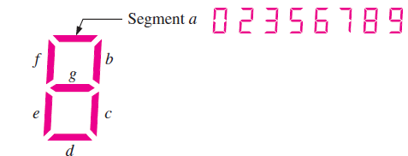
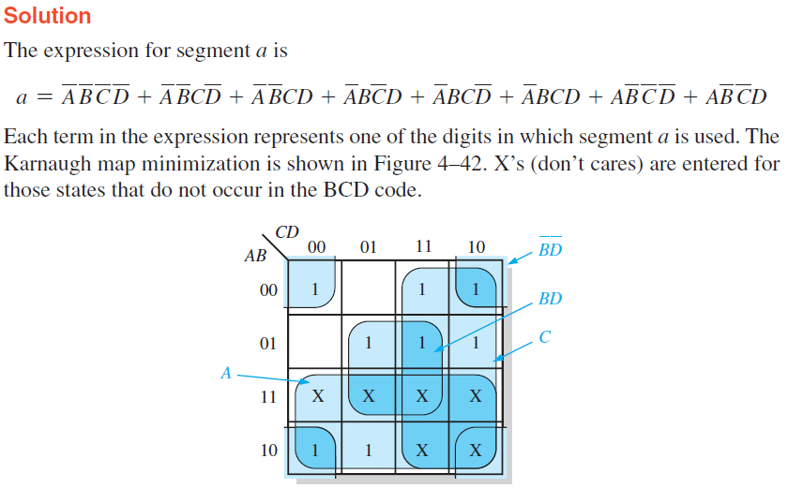

The Karnaugh Map

Slide 28
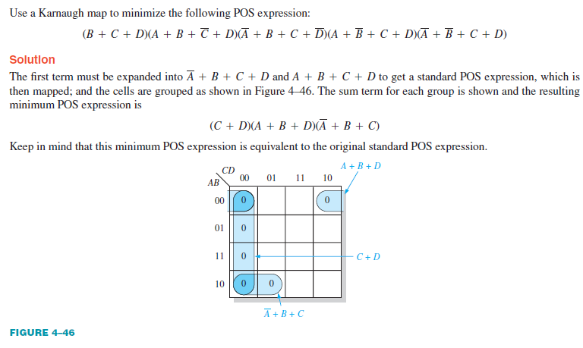
The Karnaugh Map

Slide 29
Exercise
Using Boolean notation, write an expression that is a 0 only when all of its variables (A, B, C, and D) are 0s.
Draw the logic circuit represented by each of the following expressions:
(a) A + B + C + D (b) ABCD
(c) A + BC (d) ABC + D
If you are required to choose a type of digital display for low light conditions, will you select LED or LCD 7-segment displays? Why?

Slide 30
References
Null, Linda (2024). "The essentials of computer organization and architecture". 6th edition. Jones & Bartlett Learning, Burlington, Massachusetts. ISBN: 9781284259438..
Thomas L. Floyd. (2014). “Digital Fundamentals”. 11th Edition. Prentice Hall. New Jersey. ISBN: 978-0132737968.
Introduction to K-Map: https://www.geeksforgeeks.org/introduction-of-k-map-karnaugh-map/
Karnaugh Maps, Truth Tables, and Boolean Expressions: https://www.allaboutcircuits.com/textbook/digital/chpt-8/karnaugh-maps-truth-tables-boolean-expressions/

